Slide 2
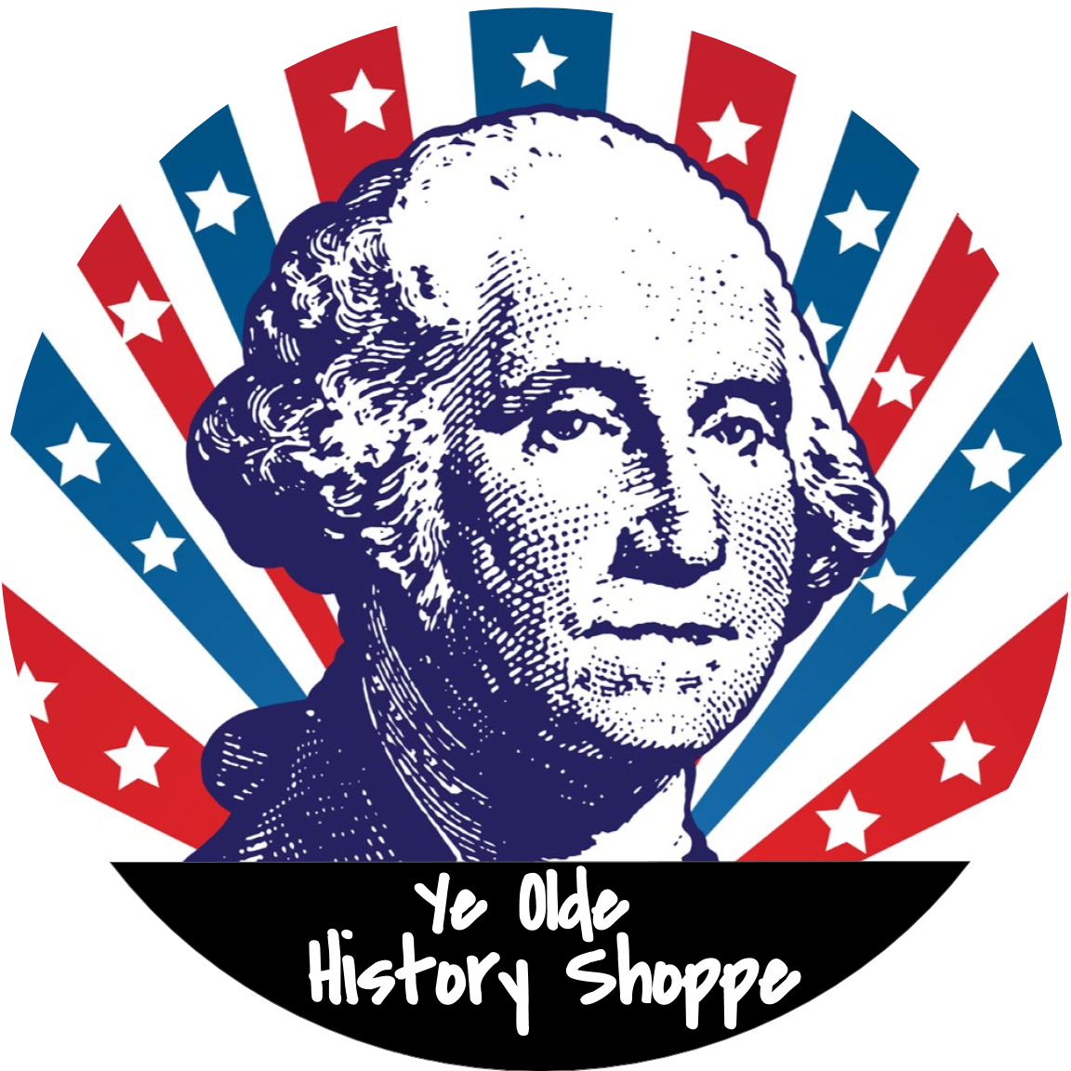
TEACHER TIPS:
How I have used these lectures:
In class: I don’t require lecture notes from my AP students but they are not permitted to use computers or work on other assignments. I do ask questions (both included & improv) throughout the lecture
Distance Learning/Flipped Classroom: Record lecture on screencast-o-matic → save video to drive & insert link to video → students take a quiz on the lecture & assigned Reading.
End of Year Review: post the full file for students to review
NOTE: Most underlined terms are hyperlinked to a video. Other videos are embedded directly to support the lecture. I will do my best to ensure they are updated, but YouTube can be tough to keep up with. Please let me know if you come across any broken links: yeoldeUShistoryshoppe@gmail.com
Everything is fully editable & you can always return to the “my purchases” page to redownload the original file
LET’S CONNECT!
→ Click the icons to find me on Instagram & Facebook
→ If you would like to join my new EMAIL LIST for access to exclusive freebies, teaching tips, and more, click here!
TERMS OF USE: This is intended to be used in your classroom & can be posted in a password protected website (like Google Classroom). Please do not post publicly. If you find this resource helpful, please take a moment to leave feedback on the “my purchases” page.

Slide 3
PERIOD 1 & 2 REVIEW
America before the Revolution: 1492 - 1754

Slide 4
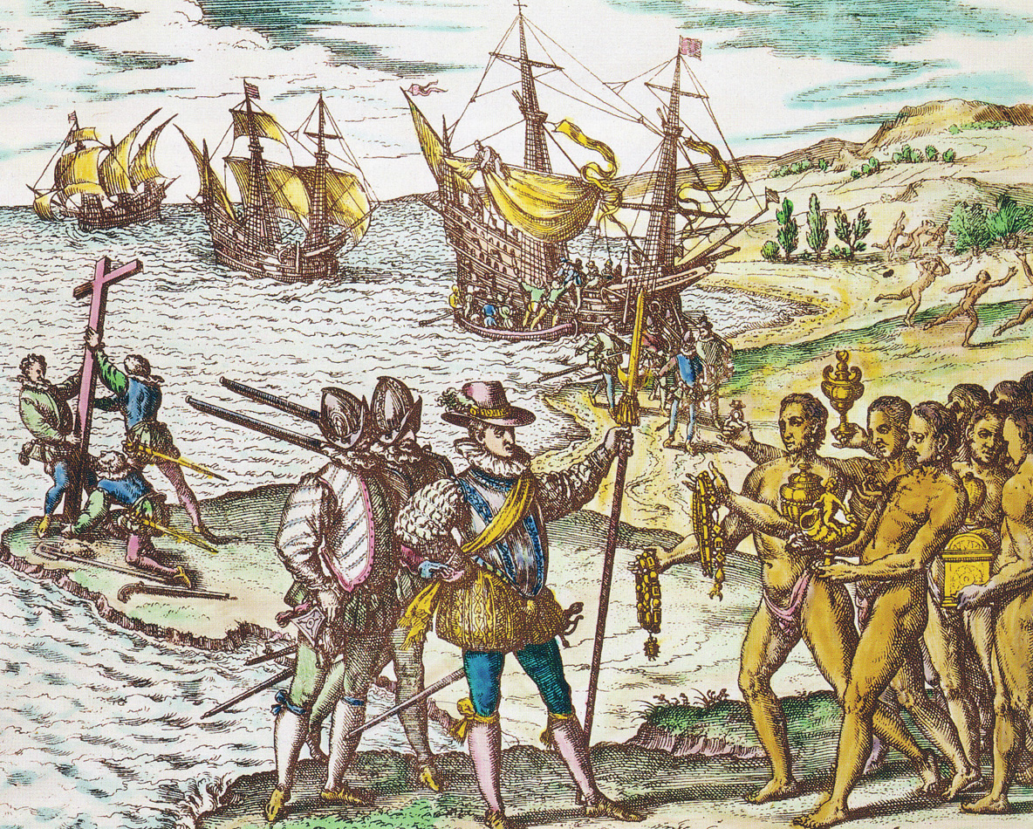
THE COLUMBIAN EXCHANGE
CONTEXT: Exploration motivated by God, gold & glory and made possible by improvements in navigation. Countries competing to control trade routes
EFFECTS:
Most significantly, native population was decimated by smallpox (almost 90% reduction in population)
European life expectancy increases with incorporation of calorically dense food like the potato
Lives of Native Americans altered significantly → horses revolutionize hunting on the plains

Slide 5
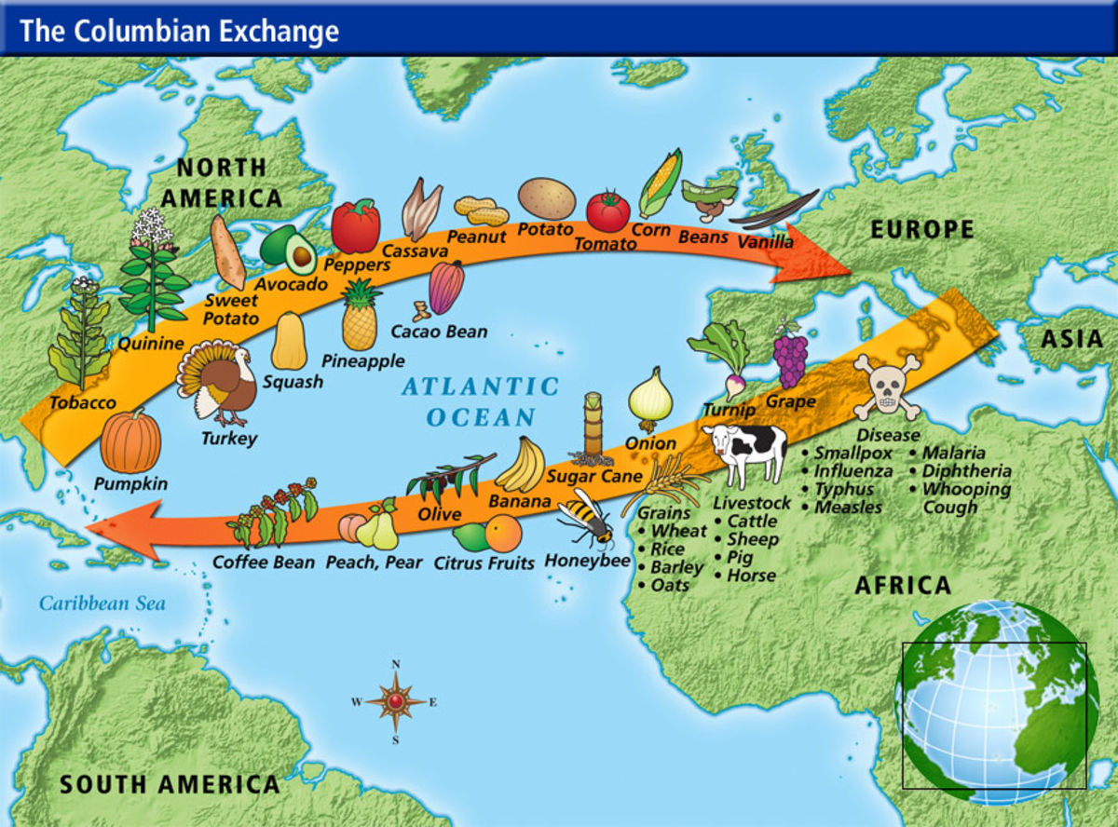

Slide 6
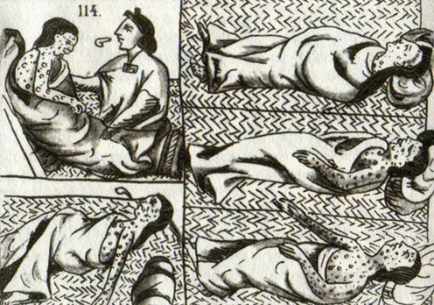
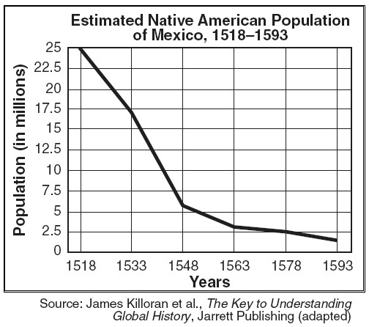

Slide 7
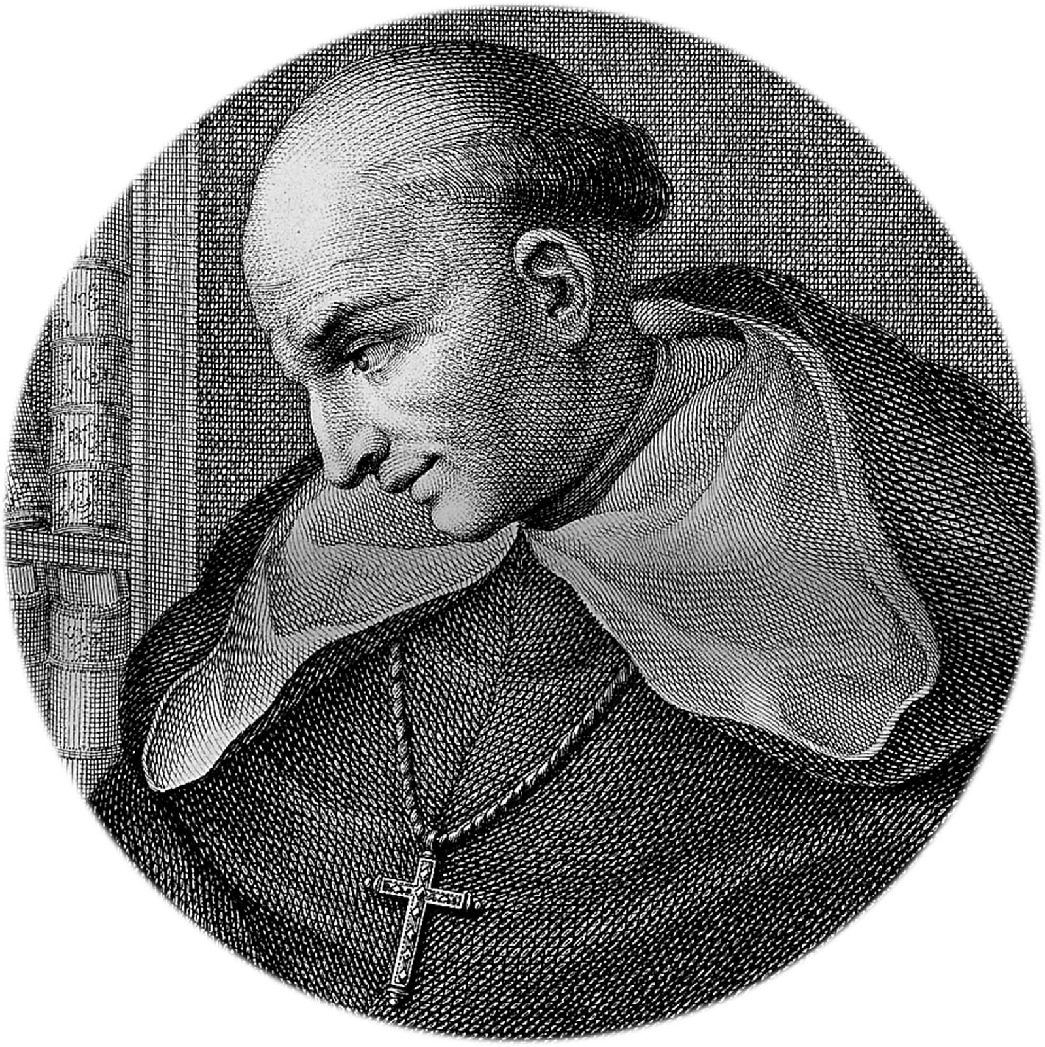
CRITIQUES OF SPANISH TREATMENT OF NATIVES
This was the first land in the New World to be destroyed and depopulated by the Christians, and here they began their subjection of the women and children, taking them away from the Indians to use them and ill use them, eating the food they provided with their sweat and toil. The Spaniards did not content themselves with what the Indians gave them of their own free will, according to their ability, which was always too little to satisfy enormous appetites, for a Christian eats and consumes in one day an amount of food that would suffice to feed three houses inhabited by ten Indians for one month. And they committed other acts of force and violence and oppression which made the Indians realize that these men had not come from Heaven. And some of the Indians concealed their foods while others concealed their wives and children and still others fled to the mountains to avoid the terrible transactions of the Christians.
HISTORICAL CONTEXT
PURPOSE
POINT OF VIEW
Bartolome de las Casas
Notes:
NOTES: CONTEXT - Spanish used the encomienda system to justify enslavement of native people under the pretense of converting them to Christianity. PURPOSE - revel hypocrisy and injustice of the Spansish system. POINT OF VIEW - as a monk himself, he would want to ensure religion was not used for ulterior motives like economic gains

Slide 8
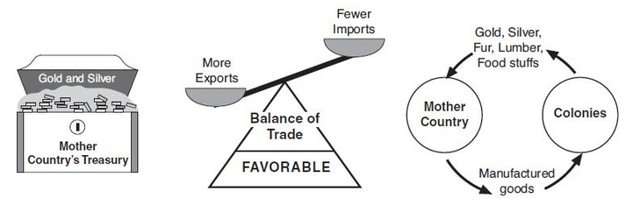
MERCANTILISM
The economic theory that a favorable balance of trade generates wealth, which a government should ensure by implementing protective laws and tariffs.
FROM SALUTARY NEGLECT TO THE NAVIGATION ACTS
Did not enforce trade regulations until the passage of the mid-17th century Navigation Acts. Under the Navigation Acts, colonists could only buy and sell goods from/to Britain. Any foreign goods had to pass through British ports first (where tariffs could be collected) → failed to significantly change colonial behavior. Molasses Act (1733) imposed heavy duties on French molasses. Dominion of New England attempted to enforce strict trade regulations but colonists revolted after Glorious Revolution

Slide 9
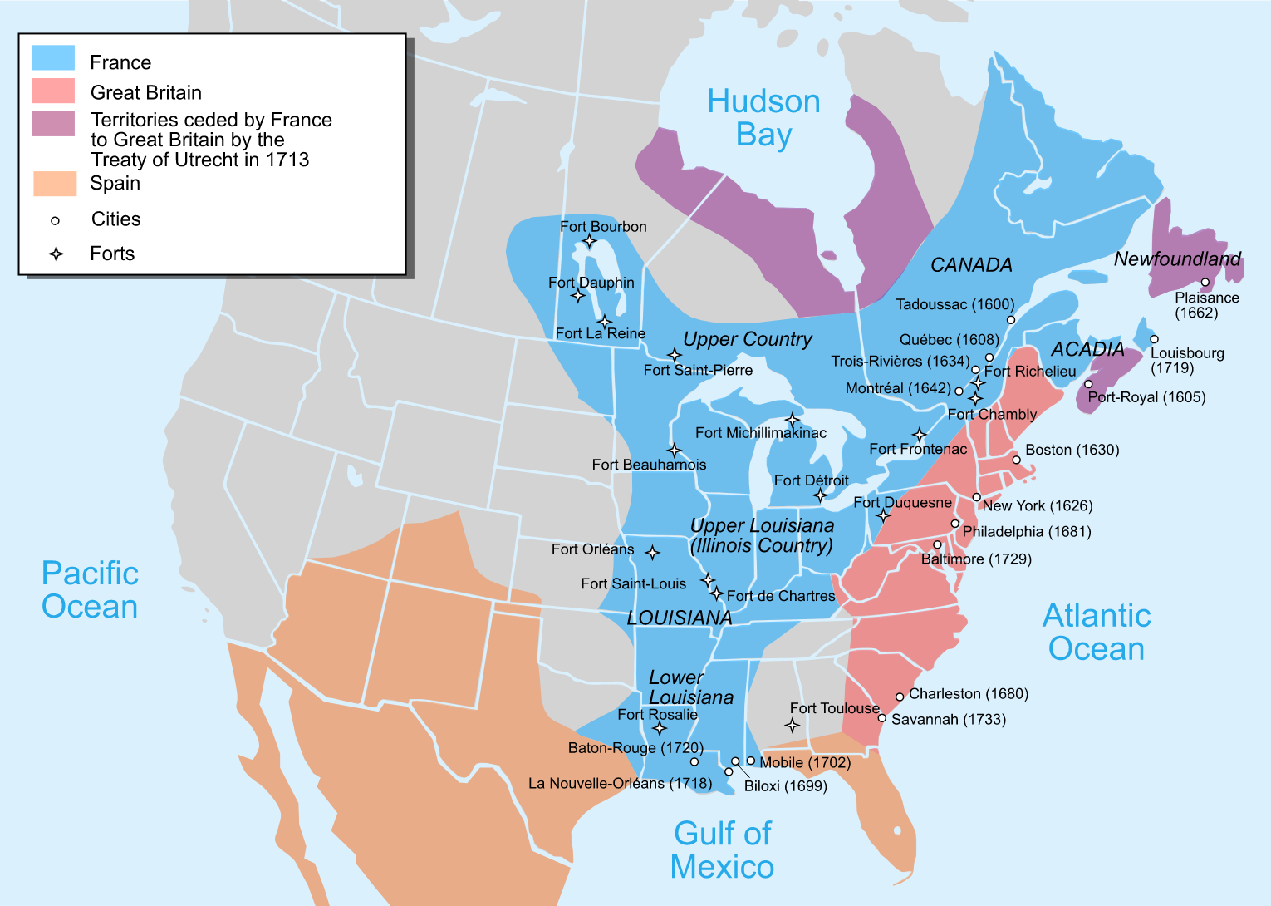
THE IMPERIAL POWERS:
COMPARE & CONTRAST

Slide 10
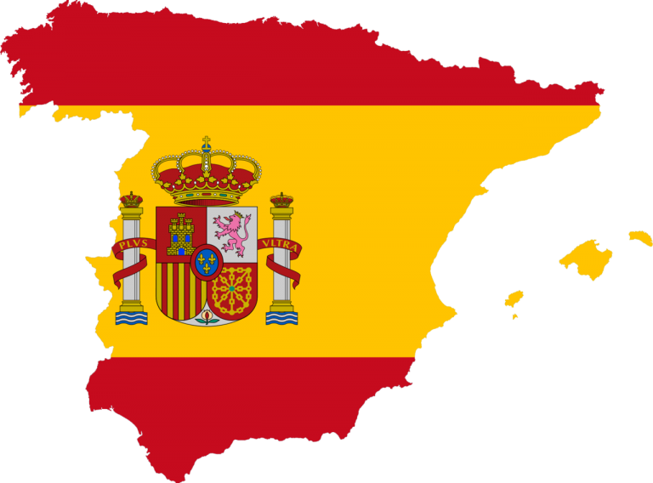
SPANISH
FRENCH
DUTCH
Conquistadors
subdued the Aztec, Maya & Inca
Established the encomienda system - the crown granted landowners rights to native labor in exchange for promises that they would Christianize them
Intermarriage common (Mestizos)
Fur trappers
Single men - made alliances with and married Native Americans
Jesuit missionaries attempted to Christianize
Primarily in Canada & West of the Appalachians (Quebec City est. 1608 by Samuel de Champlain)
Traders
Settled in New Amsterdam (est. by the Dutch West India Company in 1629)
Dutch governor Peter Minuit formally “purchased” Manhattan from the local tribe for $24
1664 - Taken over by English → “New York”

Slide 11
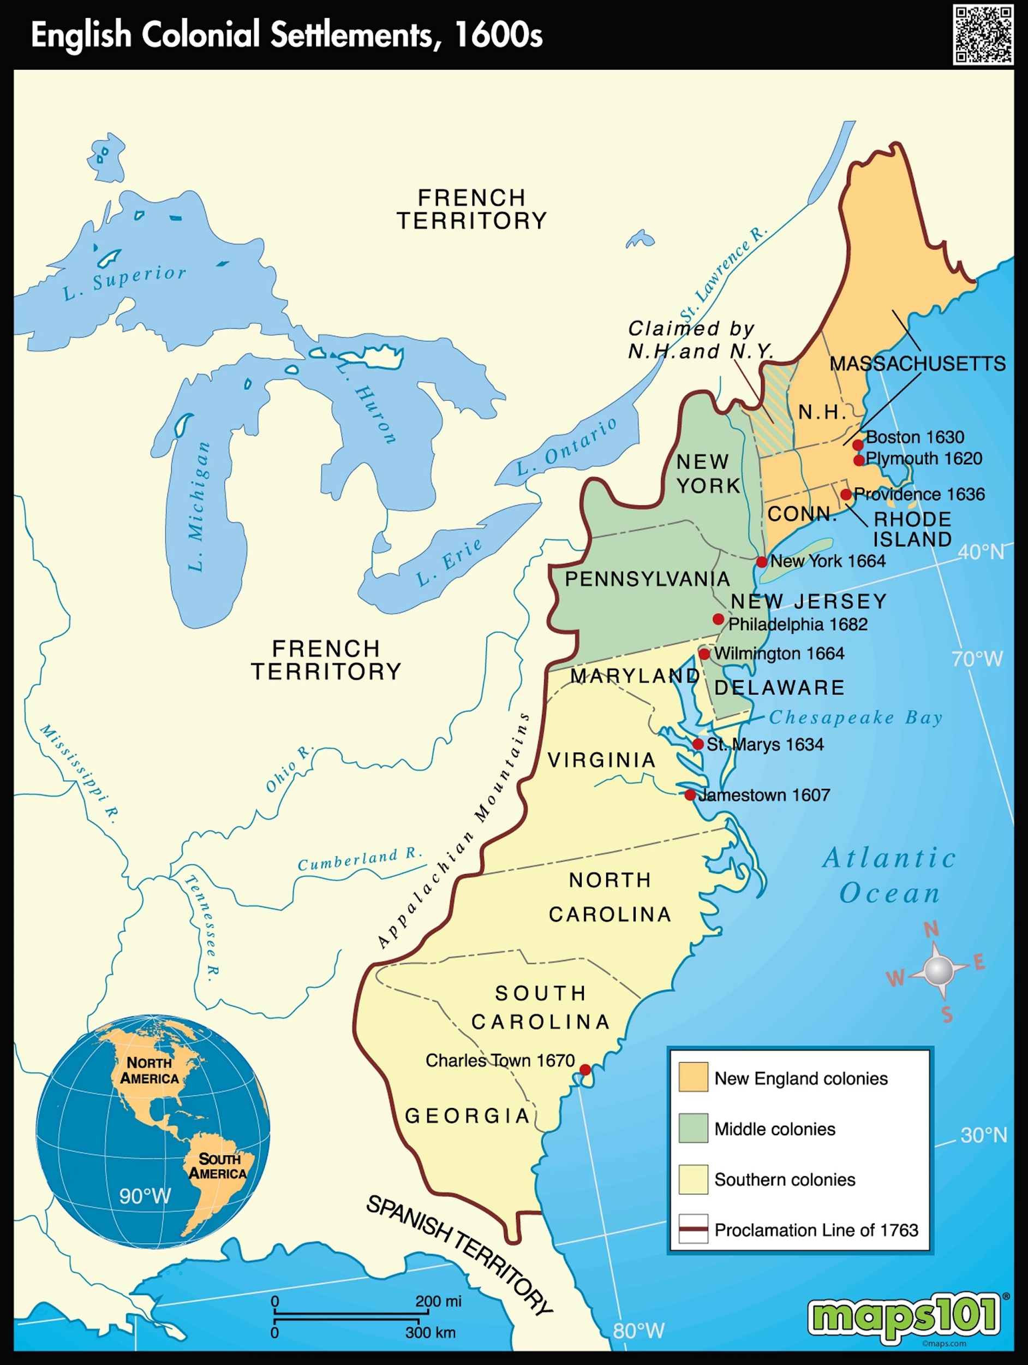
COLONIAL REGIONS
NEW ENGLAND - Puritan; settled by families; longer life expectancy--better climate and less disease; merchants & artisans; subsistence farming
MIDDLE COLONIES - “bread basket” but also trade in cities like NYC & Philadelphia
CHESAPEAKE - Virginia & Maryland: tobacco farming but also trade on the coast.
SOUTHERN COLONIES - Plantation-based; labor-intensive staple crops (rice, indigo, cotton); small number of elite plantation owners; majority small farmers

Slide 12
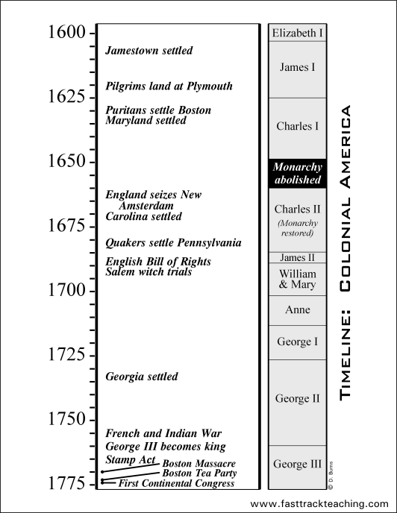
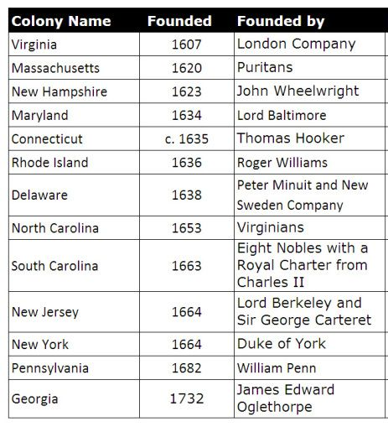

Slide 13
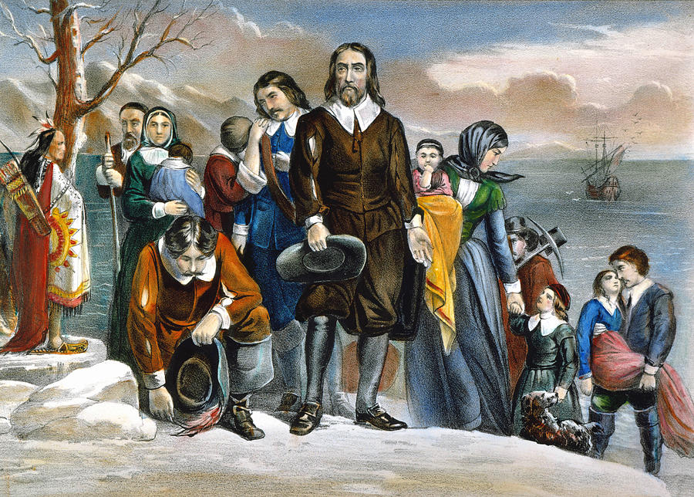
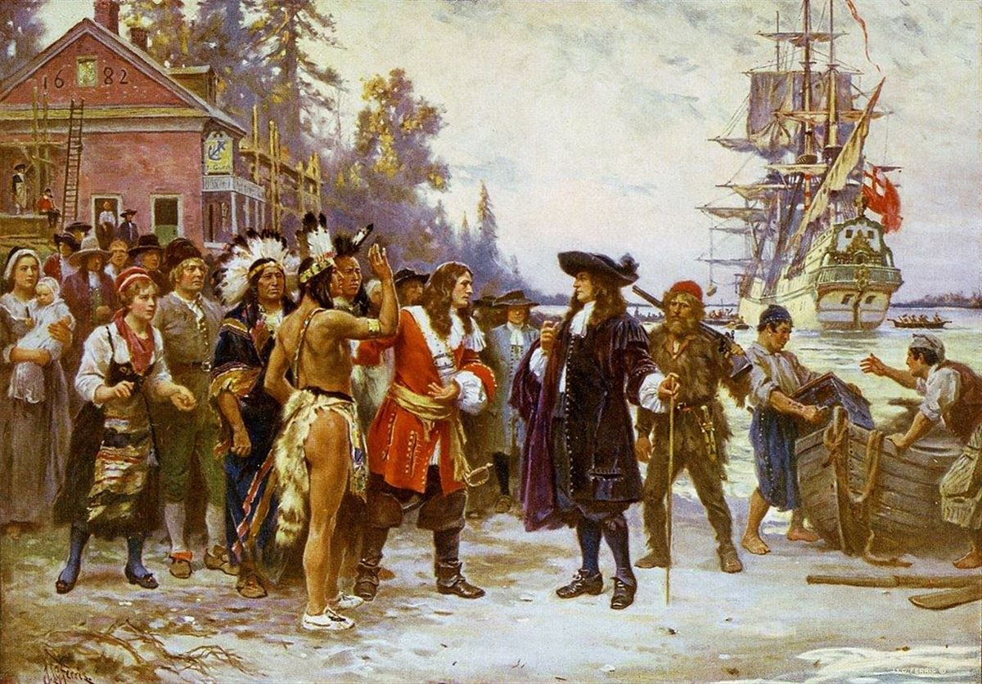
UNIQUE COLONIAL IDENTITIES
VIRGINIA - Jamestown (1607) est. by joint stock company looking for gold → “Starving time” - John Rolfe introduced tobacco
MASSACHUSETTS BAY - Pilgrims on Mayflower settled on Plymouth (1620) Separatists - wanted to create a “city upon a hill” according to John Winthrop
MARYLAND - Catholic; religious toleration for all Christians
RHODE ISLAND - Roger Williams - separation of church & state & toleration
PENNSYLVANIA - Quakers, tolerant of religions and better relationship with natives; pacifists & abolitionists

Slide 14
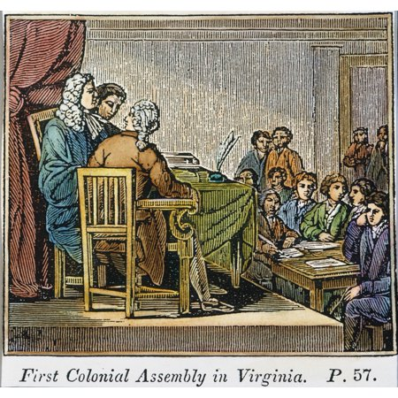
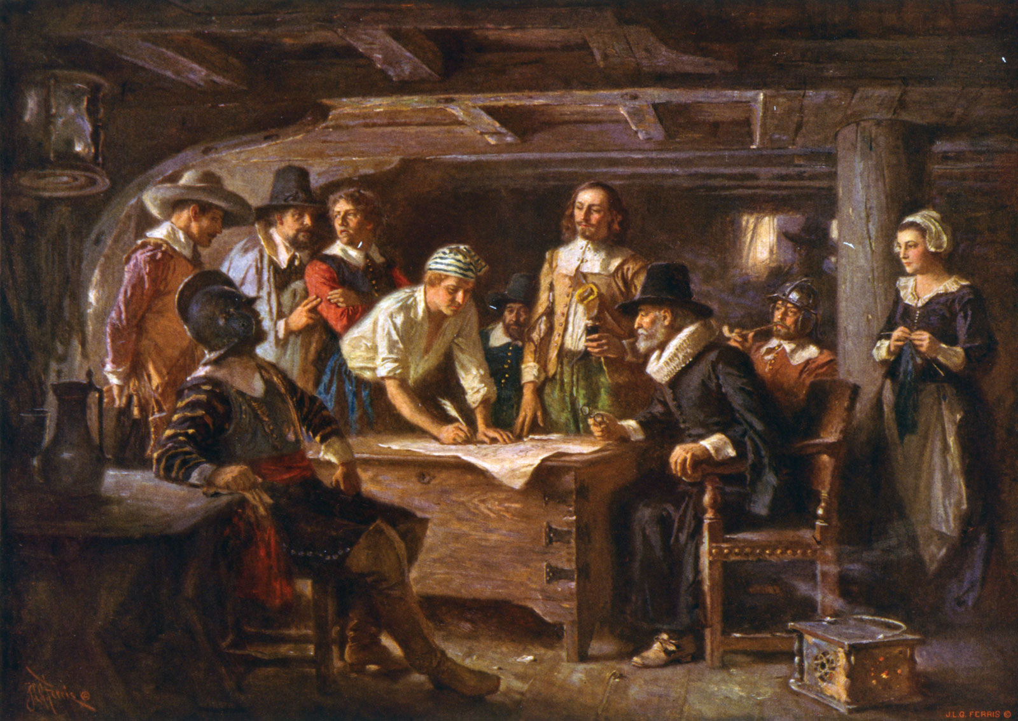
COLONIAL GOVERNMENTS
TREND: loosely controlled by Britain; experiment with self-government though all have restrictions on voting based on gender, race, property & religion.
Virginia House of Burgesses - (1619) The first elected legislative assembly in the colonies. 2 elected representatives from each county established laws and taxation
Mayflower Compact - (1620) signed aboard the Mayflower, pledging to establish a civil government with the authority to enact laws.
Fundamental Orders - (1635) Connecticut established a representative government of “substantial citizens;” considered the first constitution of the American colonies. Required both property and church membership to vote

Slide 15
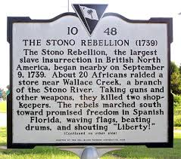
SLAVERY
TRENDS:
indentured servants more numerous than slaves until after Bacon’s Rebellion (1676).
More slaves were imported to the Indies and South America than to North America. Labor intensive crops [sugar, rice & tobacco] required a large workforce.
Middle Passage - led to the death of ⅕ of slaves
Stono Rebellion -(1739) slave revolt put down → harsher slave codes implemented

Slide 16
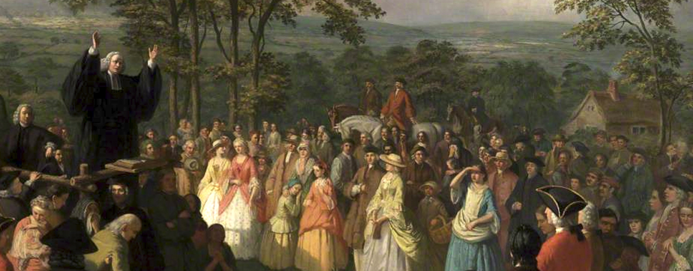
THE GREAT AWAKENING
TREND: challenged tradition, hierarchy, and quiet rationalism characteristic of colonial Protestants. Ultimately led to a more populist, democratic way of thinking.
Fiery ministers from England (Jonathan Edwards and George Whitefield) preached a more personal, emotional religion. Open-air sermons across the colonies attracted thousands of believers

Slide 17
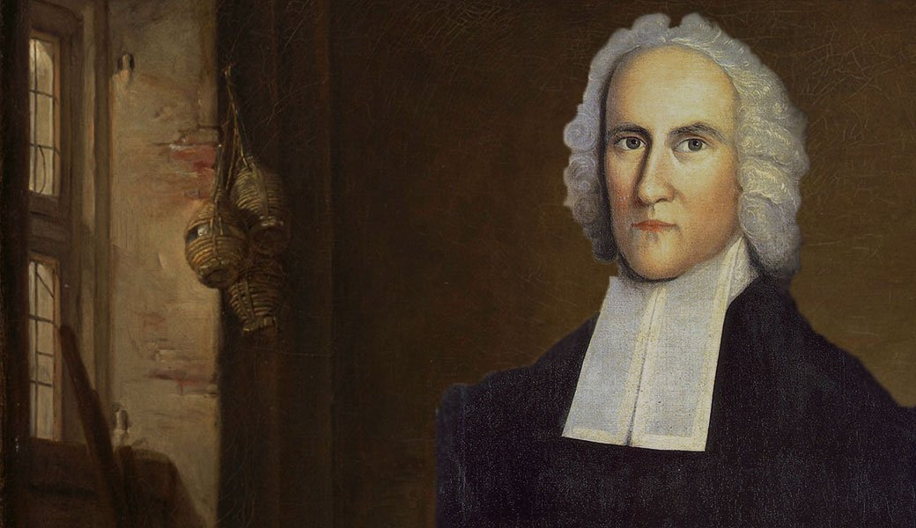
JONATHAN EDWARDS
SINNERS IN THE HANDS OF AN ANGRY GOD, 1741
So that, thus it is that natural men are held in the hand of God, over the pit of hell; they have deserved the fiery pit, and are already sentenced to it; and God is dreadfully provoked, his anger is as great towards them as to those that are actually suffering the executions of the fierceness of his wrath in hell, and they have done nothing in the least to appease or abate that anger, neither is God in the least bound by any promise to hold them up one moment; the devil is waiting for them, hell is gaping for them, the flames gather and flash about them, and would fain lay hold on them, and swallow them up; the fire pent up in their own hearts is struggling to break out: and they have no interest in any Mediator, there are no means within reach that can be any security to them. In short, they have no refuge, nothing to take hold of, all that preserves them every moment is the mere arbitrary will, and uncovenanted, unobliged forbearance of an incensed God. The use of this awful subject may be for awakening unconverted persons in this congregation.
Notes:
NOTES: The more emotional nature of the great Awakening sermons can be seen here. These would often be given out in fields or other non-traditional locations. The Great Awakening Preachers and followers were considered “New Lights”-- FUN FACT: Edwards was aaron Burr’s grandfather

Slide 18
DOCUMENT ANALYSIS
Although New England and the Chesapeake Region were both settled largely by people of English origin, by 1700 the regions had evolved into two distinct societies.
Why did this difference in development occur?
Each person in your group will summarize a document & then you will discuss your findings. Be prepared to share!
Group leader:
(create & share the doc)
Person whose first name is 1st alphabetically
Notes:
https://drive.google.com/file/d/1KBfAghsqJaWVrV1c2Q5JcWAVZ-hx5wrb/view?usp=sharing

Slide 19
DOCUMENT ANALYSIS
Make a copy & share with your group + teacher (as an editor)
Put your name by the doc
DOCUMENT 1
DOCUMENT 5
DOCUMENT 2 & 3
DOCUMENT 6
DOCUMENT 4
DOCUMENT 7
Notes:
https://drive.google.com/file/d/1KBfAghsqJaWVrV1c2Q5JcWAVZ-hx5wrb/view?usp=sharing

Slide 20
SAMPLE DOCUMENT ANALYSIS
TEACHER NOTE: You may need to make your own copy of this document to share with students due to school sharing restrictions
Winthrop was a Puritan preacher and his views on living according to God’s word are reflected here. This would shape the Massachusetts Bay colony to be focused on religion & creating a “City upon a Hill” (New England)
Social hierarchy is apparent. Mentions people looking for gold. Negative tone. Also attempted mutiny shows lack of unity, unlike New England (Chesapeake)
DOCUMENT 1
DOCUMENT 5
People of all ages – presumably families – arriving in the New England colony. More developed infrastructure like schools in the New England region. Virginia mostly men. Colony for economic gain (joint stock co)
Asking for help in defending Virginia from the Dutch. Reveals that there are a few families but many of the settlers are single men and people in debt. Shows instability too (Chesapeake)
DOCUMENT 2 & 3
DOCUMENT 6
Living more equally and communally based on the ideas of the Bible. Also see more families will inhabit the region. (New England)
Reveals the social conflict between the rich and poor. CONTEXT/POV – led the rebellion of other freed indentured servants. (Chesapeake)
DOCUMENT 4
DOCUMENT 7
Notes:
https://drive.google.com/file/d/1KBfAghsqJaWVrV1c2Q5JcWAVZ-hx5wrb/view?usp=sharing

Slide 21
THE FRENCH & INDIAN WAR:
a turning point in the relationship between England and its colonies

Slide 22
CONTEXT:
HTS: CONTEXTUALIZATION - the ability to place historical events within a larger context. Connecting an event to the bigger picture— what else was happening at the same time in different places, how this fits in with events that came before and after it, and what larger processes are at play.
→ Competition between Britain & France for global dominance in previous wars (Queen Anne’s War, War of Austrian Succession, etc.) → dispute over territory in North America: French moving south and British moving west into the Ohio River Valley.
→ Most Native Americans took the side of the French due to better relations with French settlers
→ The colonies did not share a sense of common identity, so uniting them behind the war was a challenge (evidenced by the Albany Congress of 1754)
DIRECT CAUSE: George Washington sent to protect a British fort & Virginian settlement rights when he ran into French troops. This would escalate to a full declaration of war.

Slide 23
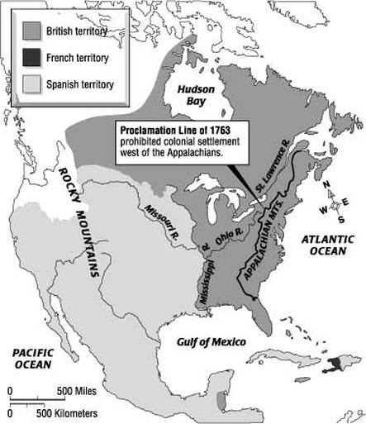
OUTCOME & EFFECTS
Treaty of Paris (1763) British gained control of Canada & everything East of the Mississippi River, but France maintained its colonies in the West Indies
Native Americans lost ability to play Europeans off each other and left to deal with the more hostile British
TENSIONS BUILD: British war debt → colonial taxes increased. After Pontiac’s Rebellion, England issued the Proclamation of 1763 forbidding settlement west of the Appalachians

Slide 24
STIMULUS BASED MULTIPLE CHOICE
55 questions on AP Exam. Many Quizzes will include SBMC

Slide 25
Huron Carol or “Twas in the moon of wintertime," composed by Jean de Brébeuf in the Native American language of the Huron people in 1643, translated by Jesse Edgar Middleton
“In excelsis gloria.
Within a lodge of broken bark
The tender babe was found
A ragged robe of rabbit skin
En-wrapped
His beauty round
But as the hunter braves drew nigh
The angel song rang loud and high [Refrain]
Jesus your King is born
Jesus is born
The earliest moon of wintertime
Is not so round and fair
As was the ring of glory
On the helpless
Infant there
The chiefs from far before
Him knelt
With gifts of fox and beaver pelt
[Refrain]”

Slide 26
The song above was most likely a 17th-century artifact from European colonization efforts of the:
English. b. French. c. Portuguese. d. Spanish.
Notes:
B. French – clues include mention of the Huron, the emphasis on religion (could be either Spanish or French), and the big clue… furs! Plus the author’s name sounds French

Slide 27
2. The European colonization model evidenced by the song above
used trade alliances and intermarriage with American Indians to acquire products for export to Europe.
established tight control over the colonization process to convert and/or exploit the population.
sent colonists to acquire land and populate their settlements while having relatively hostile relationships with American Indians.
integrated a coherent hierarchical imperial structure and pursued economic goals.
Notes:
A - knowing it was the French would be key to deducing this answer. Also there is mention of fur & pelts as the products for export

Slide 28
3. Which of the following is LEAST representative of 16th- and 17th-century European colonial practices?
A desire for new sources of wealth, increased power and status, and converts to Christianity
Attempts to change American Indian beliefs and worldviews on basic social issues such as religion, gender roles, and the family
Rapid and substantial growth of evangelical and fundamentalist Christian churches and organizations
The embrace of different social and economic goals, cultural assumptions, and folkways, resulting in varied models of colonization
Notes:
C - evangelical and fundementalist religions won’t emerge until much later (mid- 18th c). The other options are true. May be a good place to discuss examples supporting each idea with the class

Slide 29
JIGSAW LTs:
Tomorrow, you will be working with groups to become an expert on one of the 8 LTs for the unit

Slide 30
JIGSAW LEARNING TARGETS
I can explain the effects of the initial European contact with the Americas, including the Columbian Exchange.
I can describe the encomienda system and both native & European responses to Spanish colonization.
I can compare the goals of Europeans in exploration and conquest and analyze how that affected their interactions with natives.
I can discuss the unique characteristics of the British colonies on the Atlantic seaboard by region and by colony.
I can describe the transatlantic trade system that developed and how it advanced mercantilist goals
I can identify examples of cooperation & conflict between natives and Europeans
I can track the causes and effects of the rise of slavery in the colonies.
I can describe the development of political institutions in the British colonies and evaluate the extent to which they were democratic.

Slide 31
THE FRENCH & INDIAN WAR:
a turning point in the relationship between England and its colonies
BIG QUESTION:
In what ways did this mark a turning point in the relationship between England and its American colonies?

Slide 32
CONTEXT: LONG TERM CAUSES
During the late 17th & 18th c, a series of 4 global wars broke out between competing European colonial powers Britain, France, and Spain.
The winner of the struggle stood to gain supremacy in the West Indies and Canada and to dominate the lucrative colonial trade.
The first three wars between England and France focused primarily on battles in Europe and only secondarily on conflict in the colonies → European powers saw little value in sending troops to America.
In the final war [THE FRENCH & INDIAN WAR] the fighting began in the colonies and then spread to Europe.
England and France now recognized the full importance of their colonies and shipped large numbers of troops overseas to North America rather than rely on “amateur” colonial forces.

Slide 33
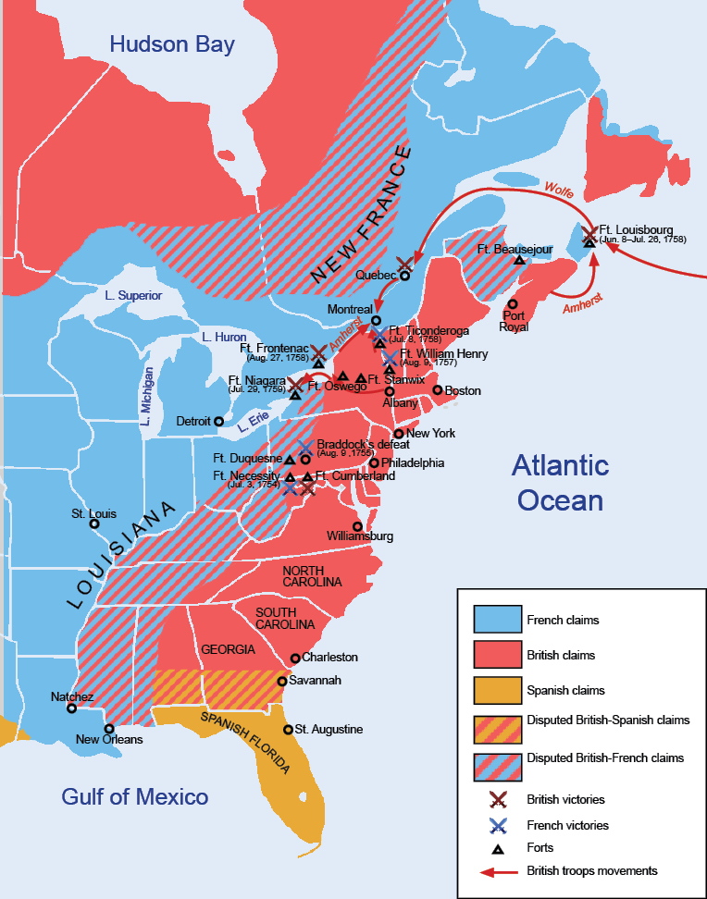
DIRECT CAUSE
From the British point of view, the French provoked the war by building a chain of forts in the Ohio River Valley.
One of the reasons the French did so was to halt the westward growth of the British colonies.
Hoping to stop the French from completing work on Fort Duquesne (Pittsburgh) and to win control of the Ohio River Valley, the governor of Virginia sent a small militia under the command of a young colonel named George Washington.
After gaining a small initial victory, Washington’s troops surrendered to a superior force of Frenchmen and their Native American allies on July 3, 1754.
With this military encounter in the wilderness, the final war for empire began.

Slide 34
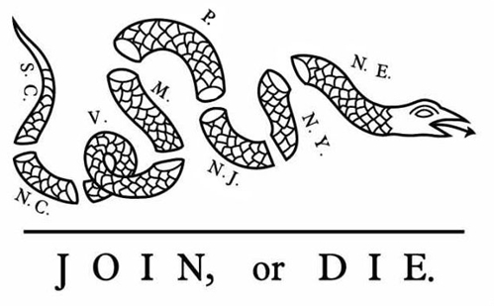
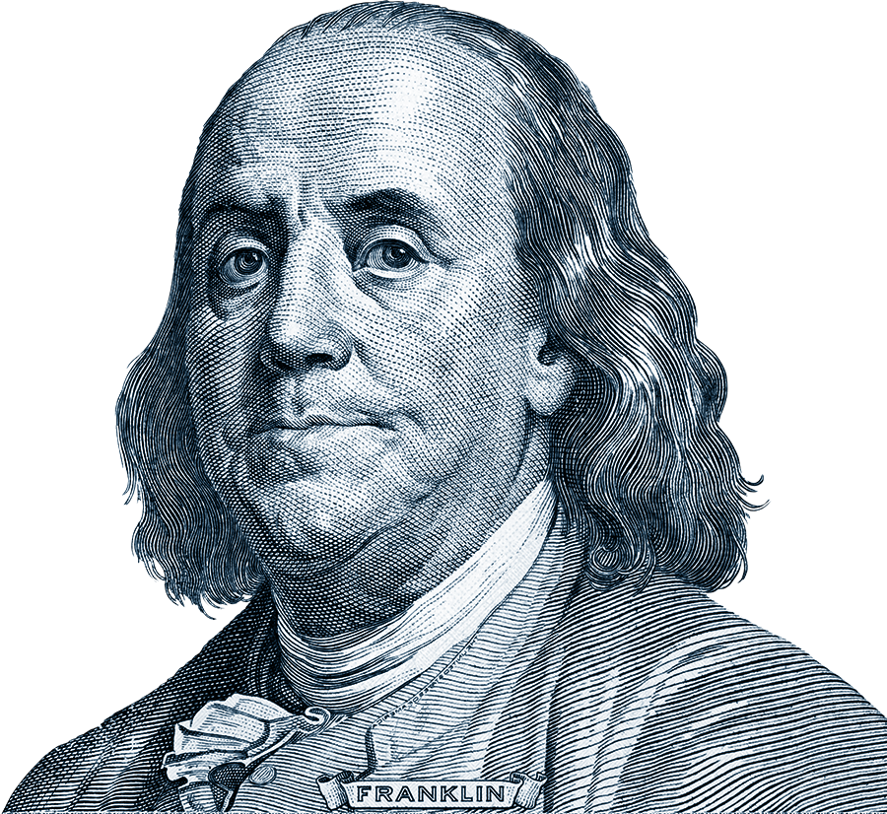
THE ALBANY PLAN OF UNION (1754)
Recognizing the need for coordinating colonial defense, the British government called for representatives from several colonies to meet in Albany, New York
The delegates from seven colonies adopted a plan—the Albany Plan of Union—developed by Benjamin Franklin
The plan provided for an intercolonial government and a system for recruiting troops and collecting taxes for their common defense.
Each colony was too jealous of its own taxation powers to accept the plan so it never took effect.
The Albany congress was significant because it set a precedent for later, more revolutionary congresses in the 1770s.

Slide 35
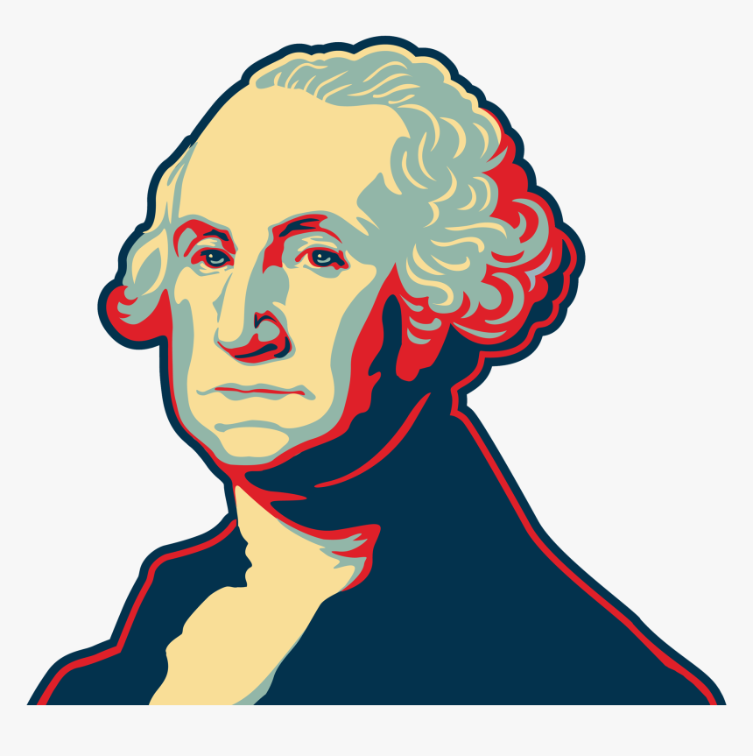
BRADDOCK’S BLUNDERS
In 1755 General Braddock led a force of 1,500 British regulars and Virginia militiamen out of Fort Cumberland in western Maryland to oust the French from Fort Duquesne
As Braddock neared the fort, the French and their Indian allies set out to ambush his force and unexpectedly met the British along a narrow roadway.
The French and Indians fanned out to attack from the woods, winning decisively
The British casualties — 450 killed, 500 wounded — included General Braddock, who later died from his wounds.
Witnessing these defeats first-hand shattered the myth of the invincibility of the British army, a realization that would embolden colonists to seek independence 2 decades later.
“[British troops] were struck with such a panic that they behaved with more cowardice than it is possible to conceive. The officers behaved gallantly, in order to encourage their men, for which they suffered greatly.”

Slide 36
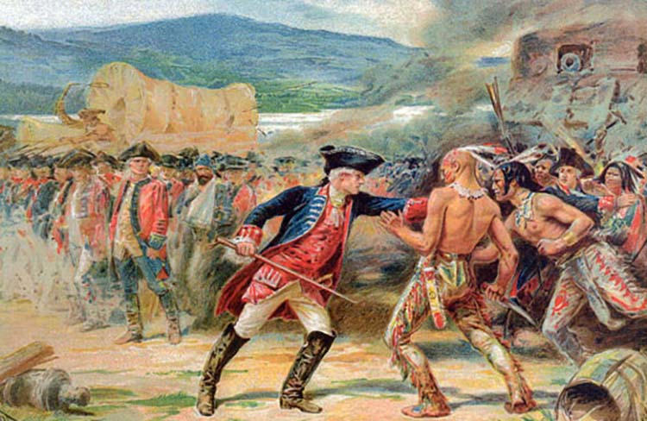
NATIVE AMERICANS TAKE SIDES
Due to more positive relationships with French colonists who often lived side-by-side with Native Americans as fur trappers and traders, the majority of Native American tribes backed the French.
However, numerous tribes remained neutral, fought alongside the British or shifted allegiances with the winds of war.
The Iroquois Confederacy, initially neutral, eventually allied with the British in 1758, while the Algonquins, their traditional rivals, backed the French.

Slide 37
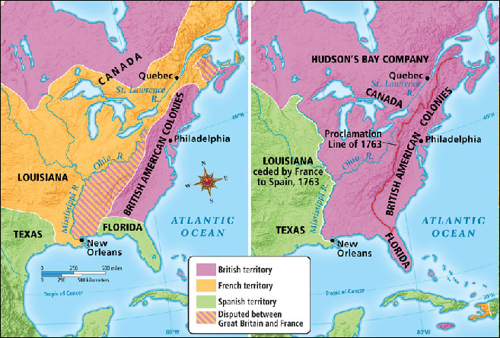
BRITISH VICTORY
In London, William Pitt, the new British prime minister, concentrated the government’s military strategy on conquering Canada.
This objective was accomplished with the retaking of Louisbourg, the surrender of Quebec, and the taking of Montreal by 1760.
With these victories and the signing of a peace treaty in 1763, the British extended their control of North America, and French power on the continent virtually ended.
Through the peace treaty (the Peace of Paris), Britain acquired French Canada and Spanish Florida.
France ceded to Spain its huge western territory, Louisiana, and claims west of the Mississippi River as compensation for Spain’s loss of Florida.

Slide 38
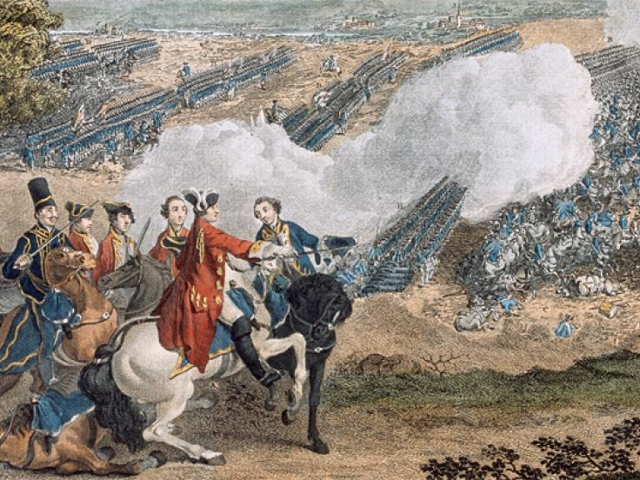
RELATIONSHIP BETWEEN BRITAIN & THE COLONISTS
The British came away from the war with a low opinion of the colonial military effort.
They considered the American militia a poorly trained, disorderly rabble.
They also noted that some of the colonies had refused to contribute either troops or money to the war effort.
The British were convinced that the colonists were both unable and unwilling to defend the new frontiers of the vastly expanded British empire.
The colonists took an opposite view of their military performance.
They developed confidence that they could successfully provide for their own defense.
Colonists were not impressed with British troops or their leadership, whose methods of warfare seemed badly suited to America’s densely wooded terrain.

Slide 39
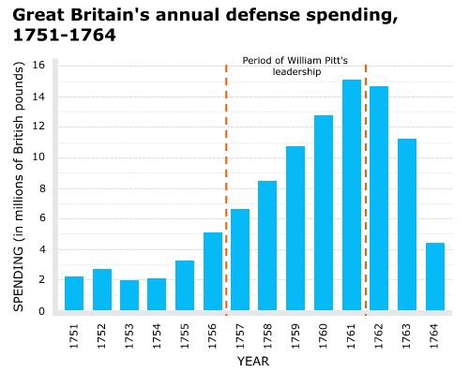
WAR DEBT & TAXATION
Previously, Britain exercised little direct control over the colonies and had allowed its Navigation Laws to go unenforced.
This earlier policy of salutary neglect was now abandoned as the British saw a need to adopt more forceful policies for taking control of their expanded North American dominions.
The wars had been extremely costly.
King George III and the dominant political party in Parliament (the Whigs) pursued a colonial policy aimed at solving Britain’s domestic financial problems.
Making the American colonies bear more of the cost of maintaining the British empire would lead to increased colonial taxes which were not well-received in the colonies.
Notes:
Sources: AMSCO US History

Slide 40
LET’S REFLECT:
In what ways did this mark a turning point in the relationship between England and its American colonies?
Notes:
NOTES: Most important turning point: end of salutary neglect & increase of taxes & other legislation like Proclamation of 1763. Also, emboldened the colonists militarily & shattered the myth of British military invincibility. Gave rise to leaders like Washington. These changes would directly lead to the American Revolution. However, colonies still remained largely un-unified & committed to their states (Franklin’s failed Albany Plan of Union)

